Slide 1
Data-Driven Software Sustainability
CW3S19, 24 July 2019
Daniel S. Katz
(d.katz@ieee.org, http://danielskatz.org, @danielskatz)
Assistant Director for Scientific Software & Applications
Research Associate Professor, CS, ECE, iSchool

Slide 2
What is sustainability?

Slide 3
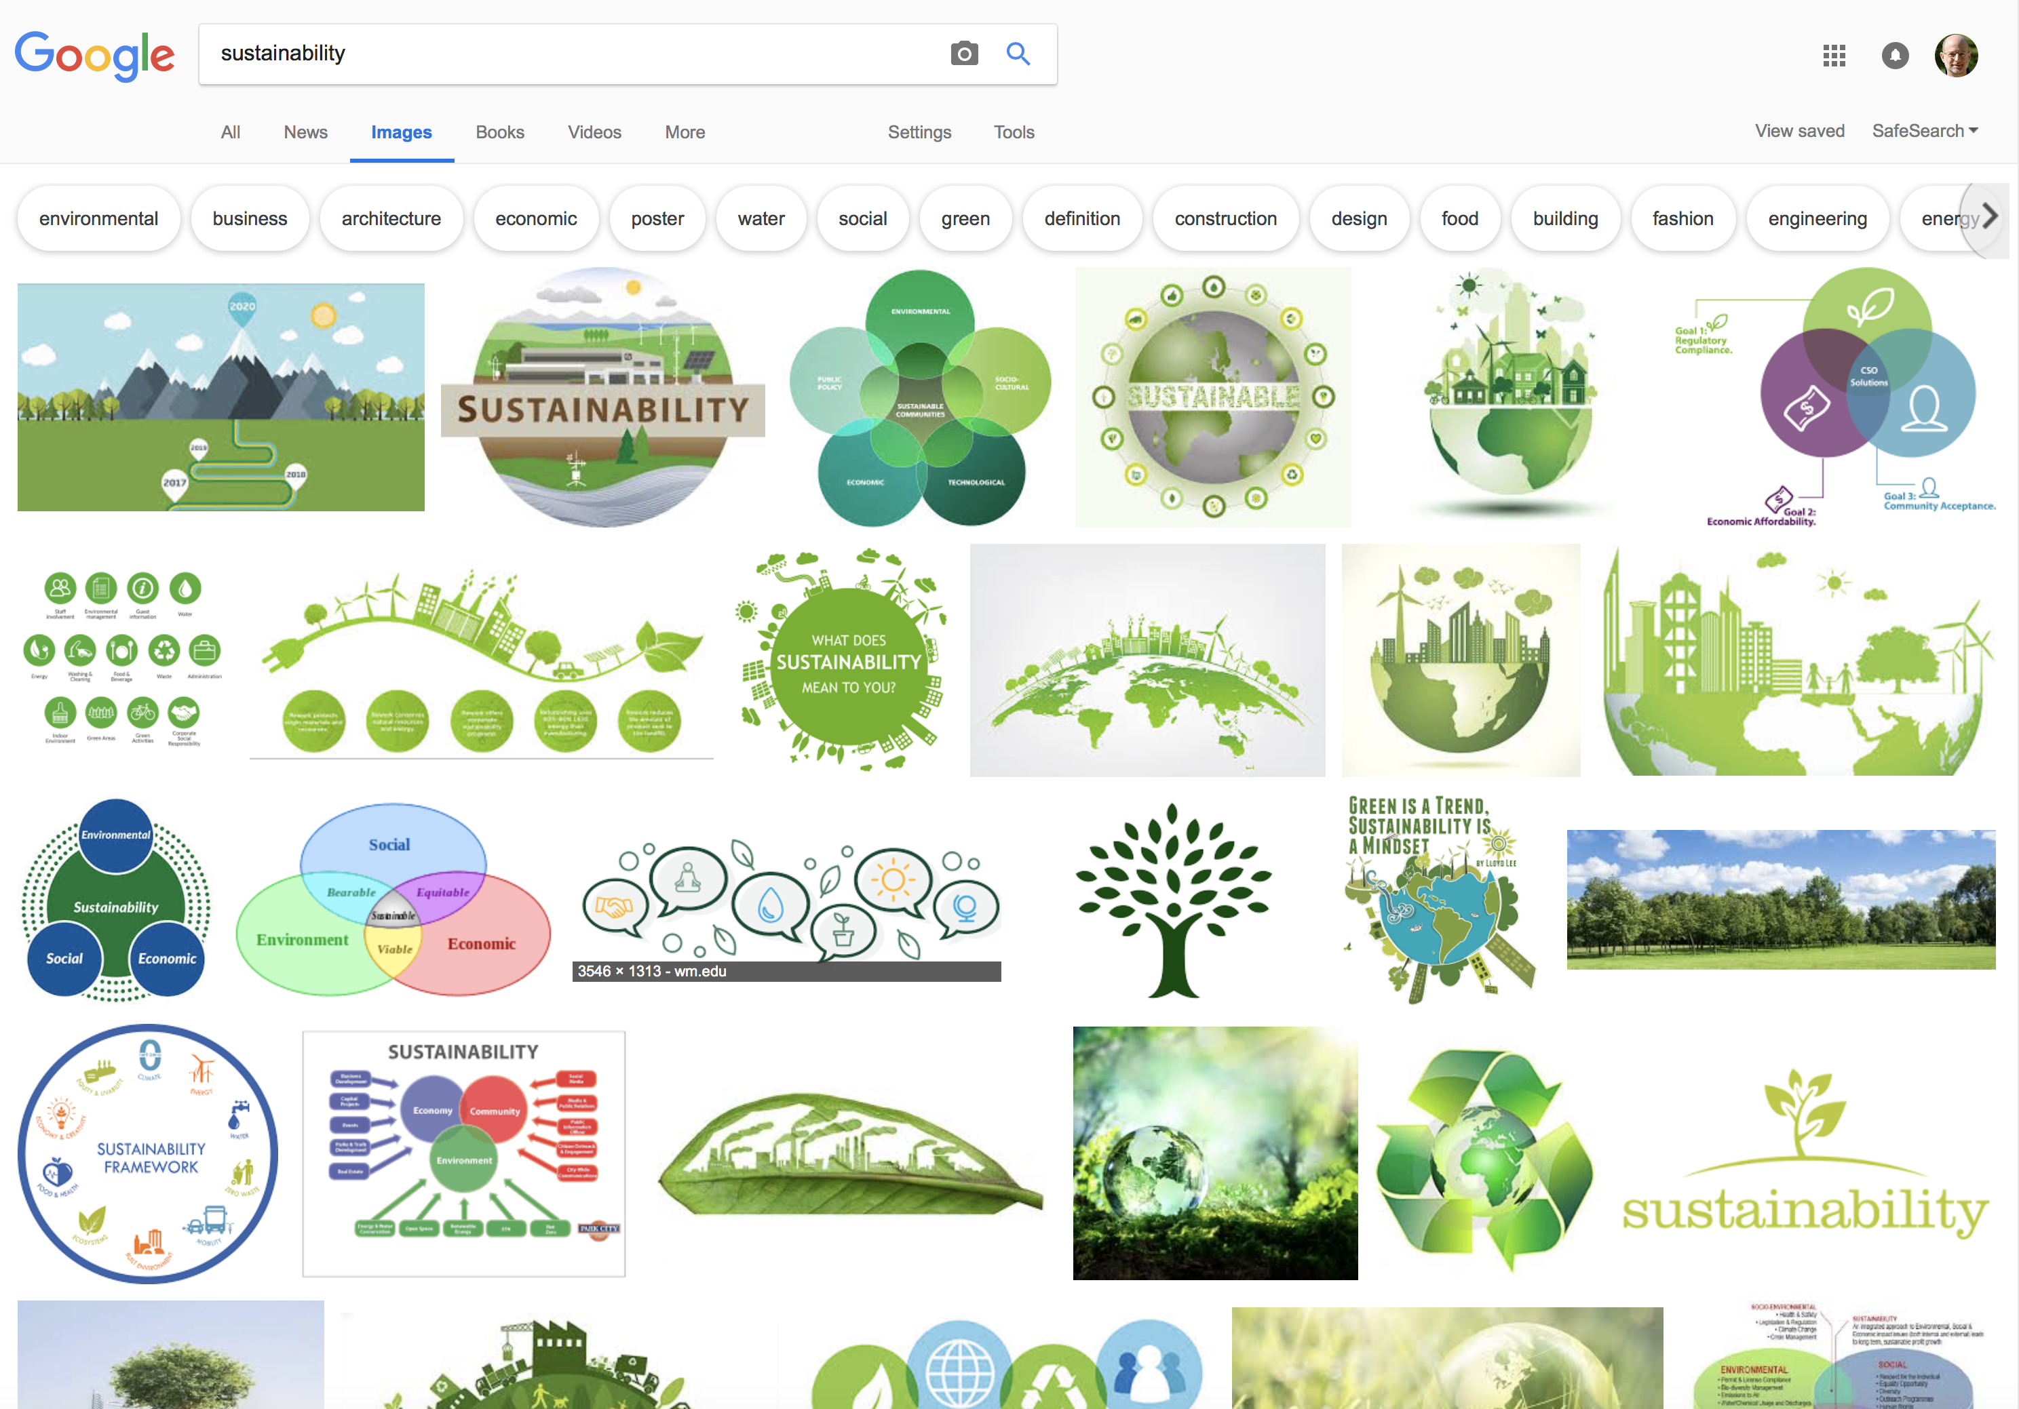

Slide 4

What is sustainability?
Most often used in the context of ecology, often specifically in the relationship between humans and the planet
Example: Karl-Henrik Robèrt (via Wikipedia & paraphrased)
Natural processes are cyclical but we process resources linearly
We use up resources, resulting in waste
Waste doesn’t find its way back into natural cycles; not reused or reassimilated
Call for "life-styles and forms of societal organization based on cyclic processes compatible with the Earth's natural cycles"

Slide 5
Two views on software sustainability
1. Software sustainability focuses on the software ecosystem
The software ecosystem should be permanently sustained, even though individual packages will die over time

Slide 6

Sustainability in the context of software
Elinor Ostrom’s (Governing the Commons) definition of sustainability for a common-pool resource (CPR): “As long as the average rate of withdrawal does not exceed the average rate of replenishment, a renewable resource is sustained over time.”
Notion of a cyclic property, though cycle period not specified
But rate (sustainability) of what?
Titus Brown: “the common pool resource in open online projects is effort”
We need to sustain overall effort by encouraging/rewarding open source activities
With enough effort, needed software will be sustained
C. T. Brown, “A framework for thinking about Open Source Sustainability?” http://ivory.idyll.org/blog/2018-oss-framework-cpr.html

Slide 7
Two views on software sustainability
1. Software sustainability focuses on the software ecosystem
The software ecosystem should be permanently sustained, even though individual packages will die over time
2. Software sustainability focuses on individual packages
Permanently sustaining software packages is not a goal
But some packages need to be kept working
Define sustainability as the capacity of the software to endure
Will the software will continue to be available in the future, on new platforms, meeting new needs?

Slide 8

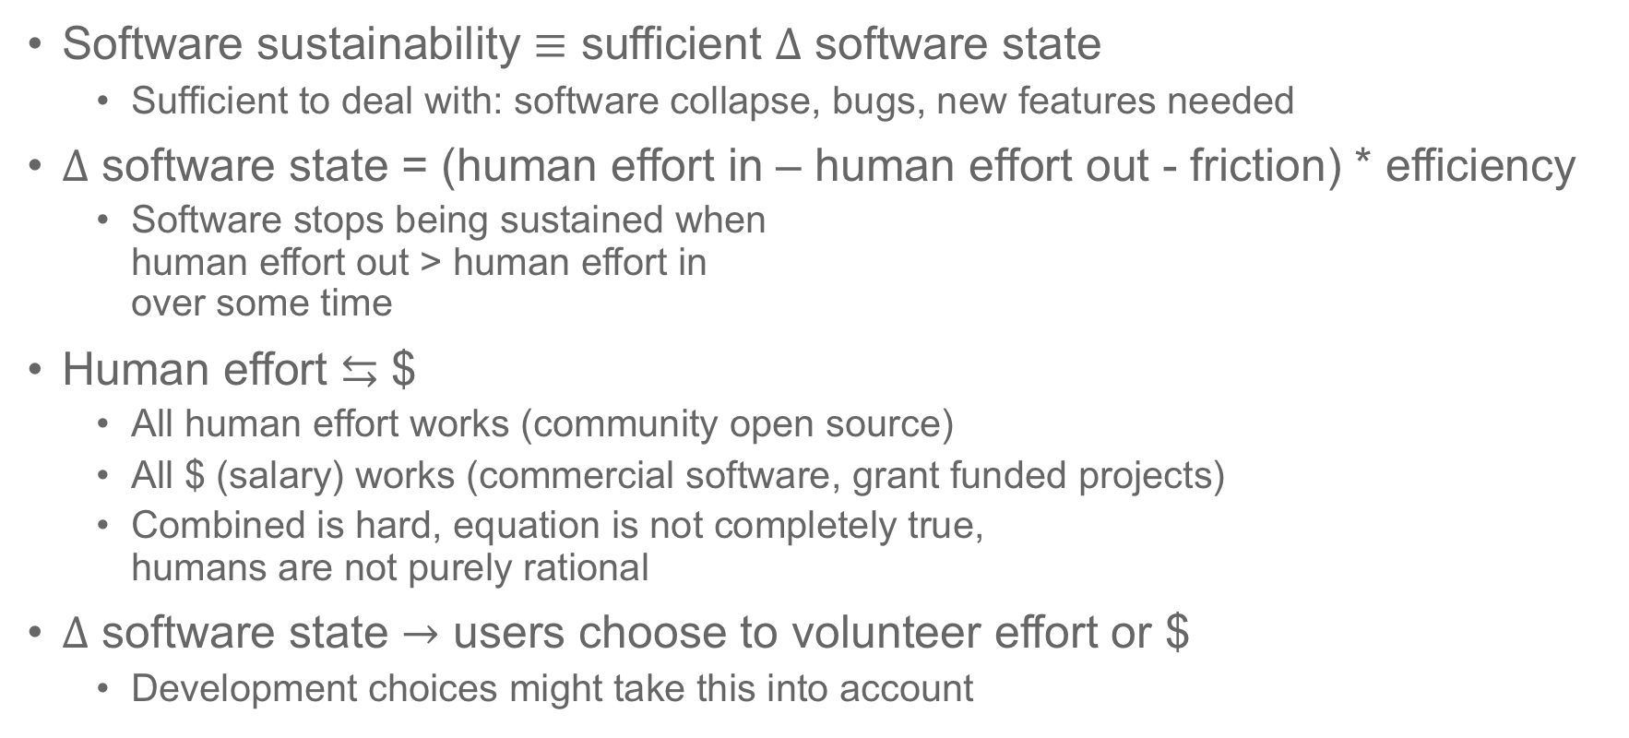
“Equations” of software sustainability
Software sustainability $≡$ sufficient $∆$ software state
Sufficient to deal with: software collapse, bugs, new features needed
$∆$ software state = (human effort in – human effort out - friction) * efficiency
Software stops being sustained when human effort out > human effort in over some time
Human effort $⇆$ $
All human effort works (community open source)
All $ (salary) works (commercial software, grant funded projects)
Combined is hard, equation is not completely true, humans are not purely rational
$∆$ software state $→$ users choose to volunteer effort or $
Development choices might take this into account
?
Debt: The First 5,000 Years
by David Graeber

Slide 9
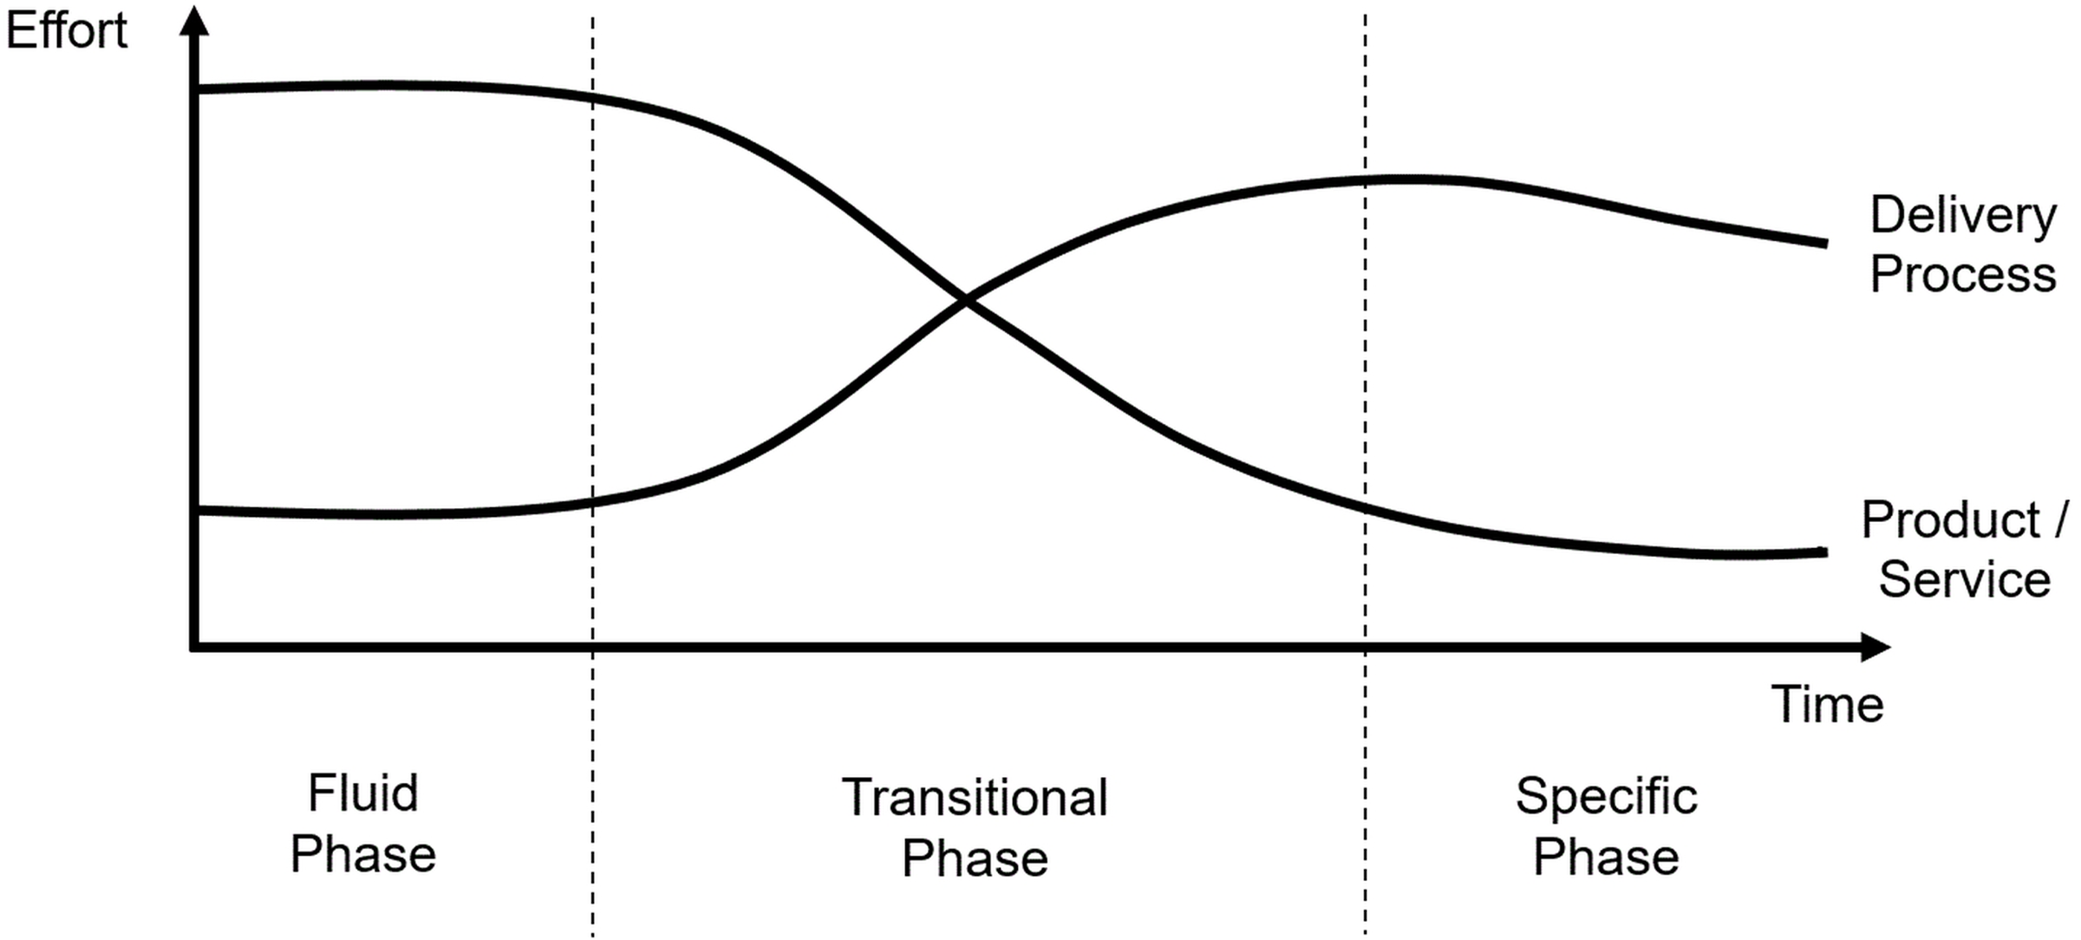
Needed type of effort changes over time
For both single package or for ecosystem of packages
Leng J, Shoura M, McLeish TCB, Real AN, Hardey M, McCafferty J, et al. (2019) Securing the future of research computing in the biosciences. PLoS Comput Biol 15(5): e1006958. https://doi.org/10.1371/journal.pcbi.1006958

Slide 10

Who starts new software projects?
User/Developer
To scratch their own itch
Then options:
Keep it for myself
Share it
Accept contributions (effort), and if so:
Broaden focus?
Bring together other (related) packages
Broaden governance?
Collaborate with other developers

Slide 11
Why do people lead and contribute to projects?
Engagement: meaningful and valuable actions that produce a measurable result
Engagement = Motivation + Support – Friction
Intrinsic motivation: self-fulfillment, altruism, satisfaction, accomplishment, pleasure of sharing, curiosity, real contribution to science
Extrinsic motivation: job, rewards, recognition, influence, knowledge, relationships, community membership
Support: ease, relevance, timeliness, value
Friction: technology, time, access, knowledge

Slide 12
Systemic improvements
Credit for developers and maintainers
Software citation
FORCE11 Software Citation Implementation Working Group
Career paths for developers and maintainers
Research Software Engineer Association
Society of Research Software Engineers (UK)
US-RSE Association
Document best practices (or good enough practices)
Underway by lots of communities
E.g. The Carpentries, SSI, URSSI, BSSw, ELIXIR, …

Slide 13
Project-specific choices
Which features should be added next?
Which PR should be accepted next?
These decisions partly depend on the developer’s needs
And of course, on impact on current and new users
Now, add their impact on sustainability as a factor
If PR 1 will make the project harder to sustain and PR 2 will make the project easier to sustain, …
If adding feature A will bring in new developers, and feature B will not, …
If Funder X is interested in …

Slide 14

How can we determine these?
Measure current community health
By CHAOSS metrics or other means
Estimate community health under various options
How? Not clear, but some ideas:
Look at past projects and their similar decisions; use these to project the possible impact of future decisions in new projects
Run role-playing exercises with real developers and real users
Perform A/B testing with real projects
Gather data from successful and unsuccessful projects; tie anecdotes about these projects to their outcomes
Survey leaders of successful projects to understand what choices they would make in a particular situation

Slide 15
Summary
Define sustainability as
Inflow of resources sufficient to do the needed work
Those resources can be turned into human effort
Generic methods to improve sustainability
Bring in more resources (funding, people) - incentives
Reduce the needed work – best practices
Project-specific methods to improve sustainability
Consider impact of project decisions on sustainability, not just developer needs and current/new user needs
Research needed into how to do this

Slide 16

Talk to me if you want a JOSS (Journal of Open Source Software) sticker

